Slide 1

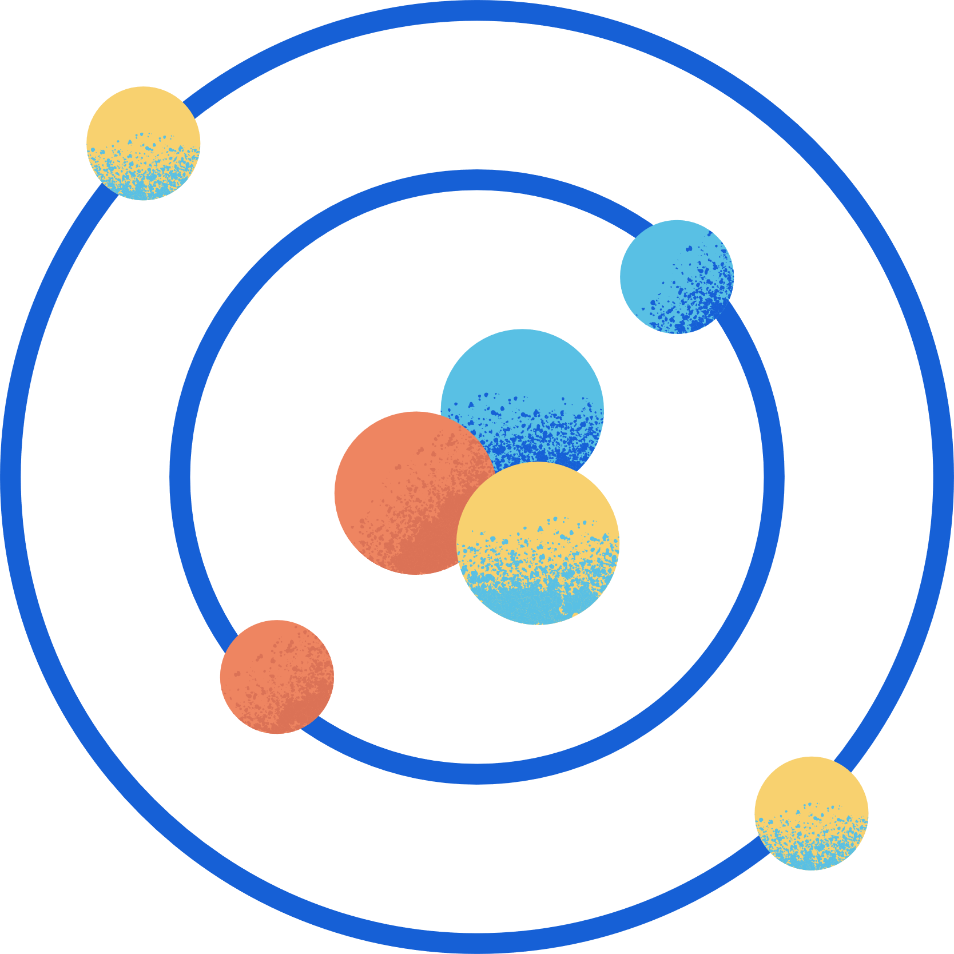





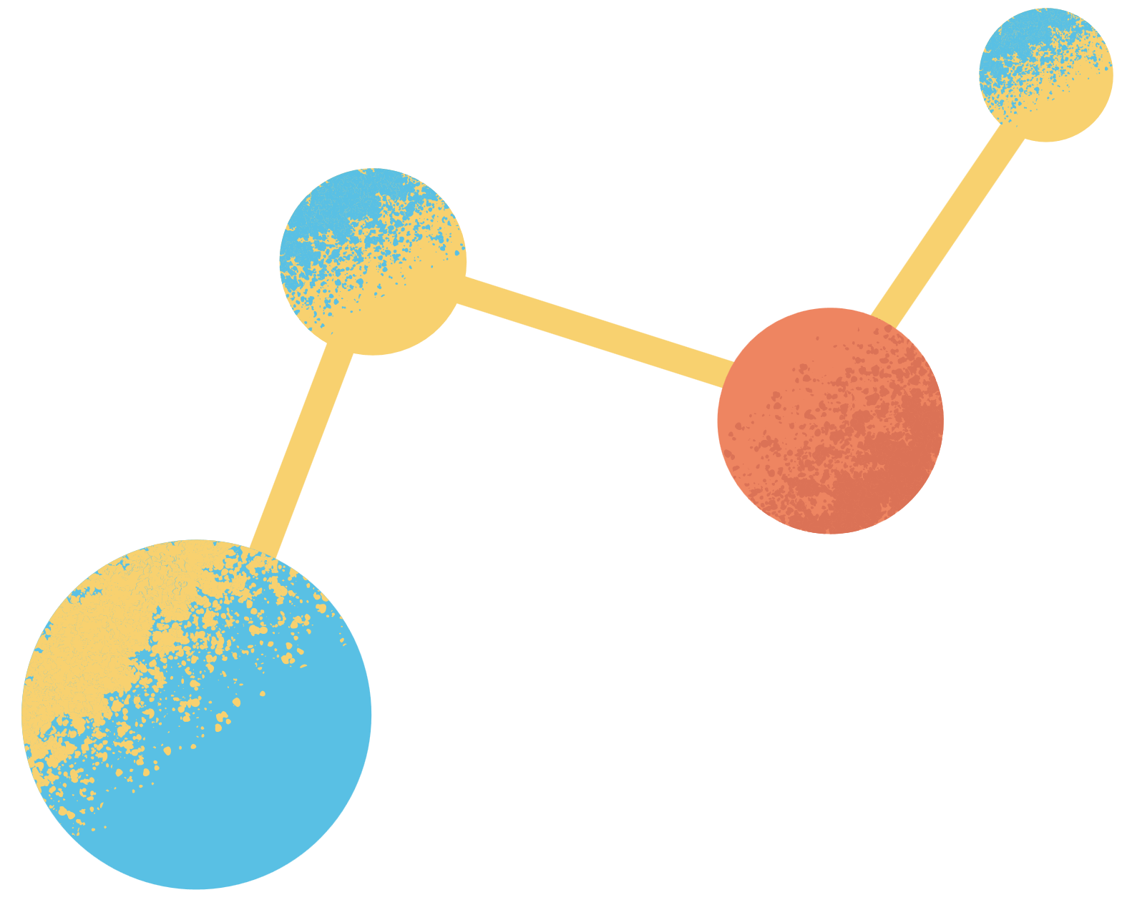

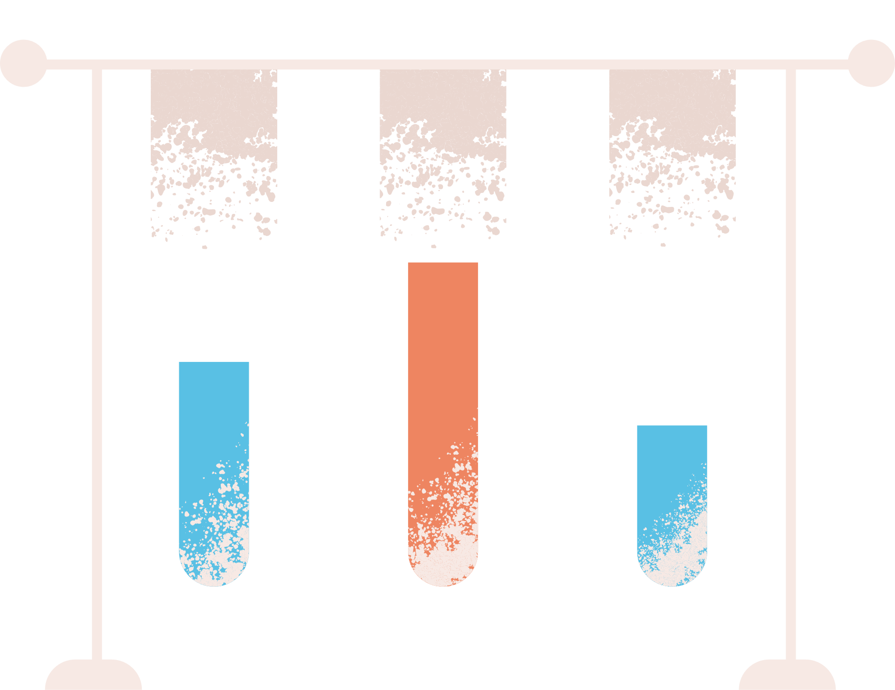

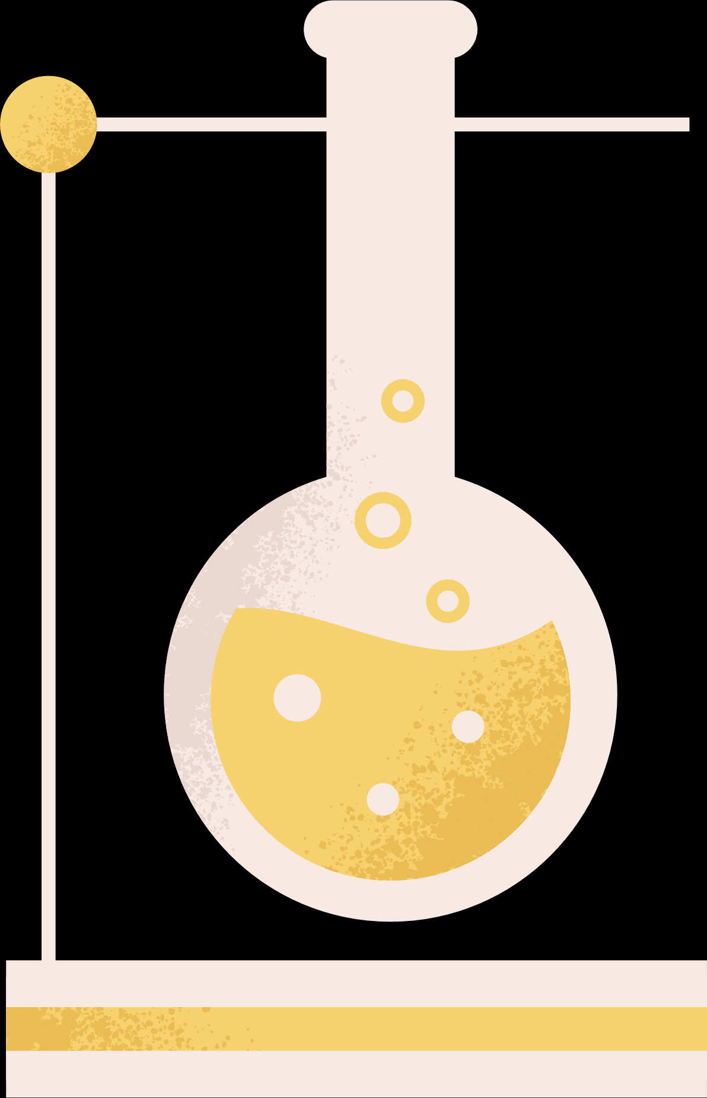
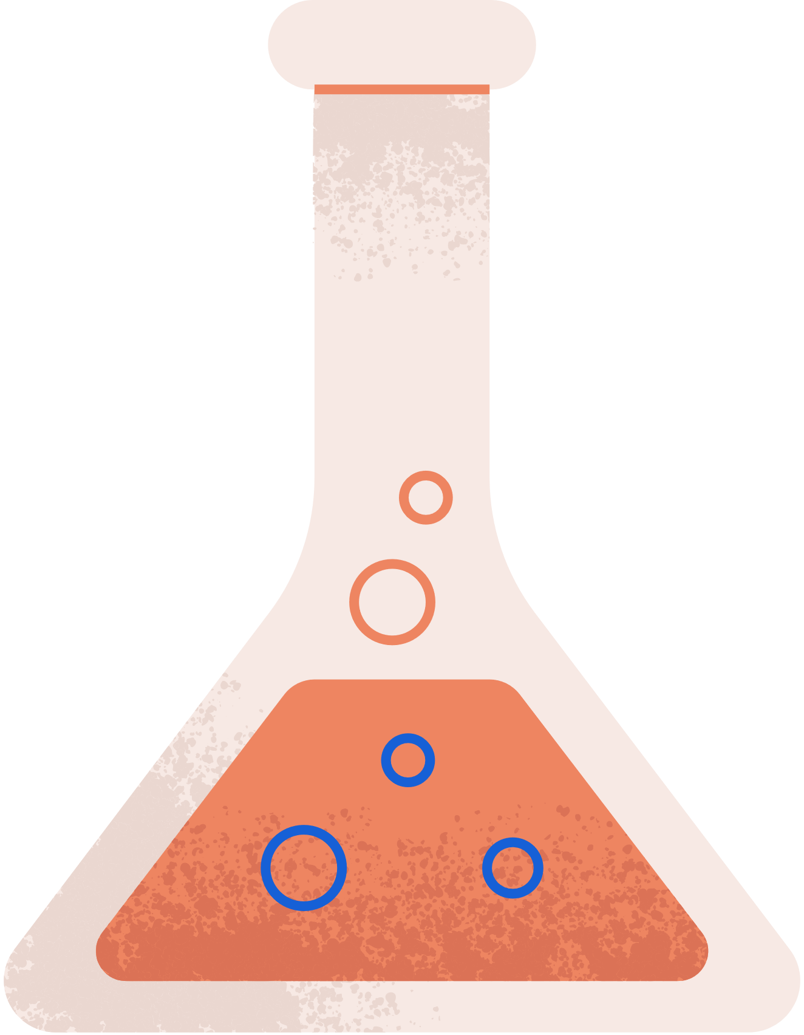
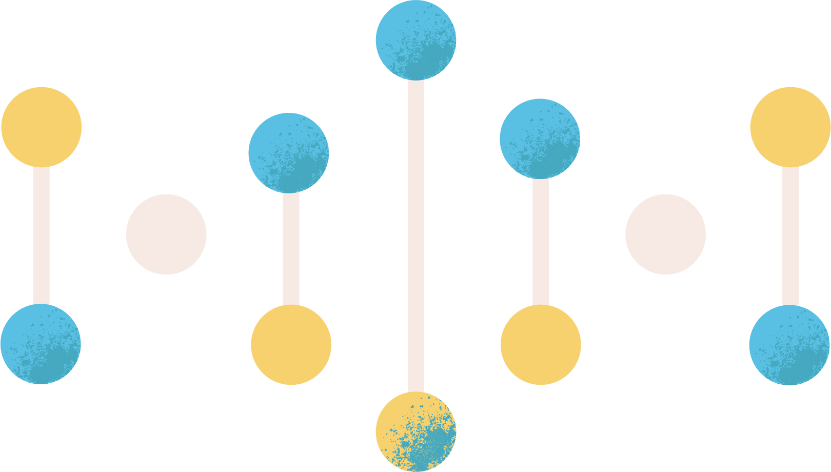


CHEMICAL KINETICS
& CHEMICAL EQUILABRIUM
PRESENTED BY:
RUBAIYA NURA JANNAT
ID: 241311091

Slide 2
LESSONS’S
Introduction to Chemical Kinetics
The Law of Mass Action
Equilibrium Constant (K_eq)
Le Chatelier’s Principles

Slide 3
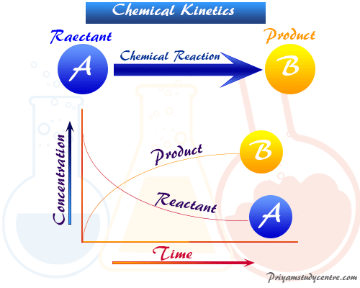
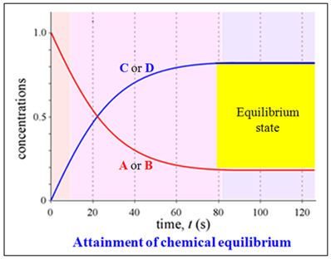
CHEMICAL KINETICS & EQUILIBRIUM
Chemical Kinetics:
The study of the speed of chemical reactions and the factors that influence it.
Chemical Equilibrium:
A state in a reversible reaction where the rates of the forward and reverse reactions are equal, resulting in constant concentrations of reactants and products.

Slide 4



The Law of Mass Action
The Law of Mass Action is a fundamental principle in chemical kinetics that describes the relationship between the concentration of reactants and the rate of a chemical reaction. It states that the rate of a reaction is directly proportional to the product of the concentrations of the reactants, with each concentration raised to a power equal to its coefficient in the balanced chemical equation.
Mathematical Expression
For a reaction,
aA + bB → cC + dD the rate of the reaction can be expressed as:
Rate = k[A]^a[B]^a
Here, k is the rate constant, [A] and [B] are the concentrations of the reactants, and a and b are the stoichiometric coefficients from the balanced equation.

Slide 5
Equilibrium Constant of Reaction
The equilibrium constant (K) of a chemical reaction is a mathematical relationship that describes the relative amounts of products and reactants at equilibrium. It is calculated by dividing the concentrations of the products raised to their stoichiometric coefficients by the concentrations of the reactants raised to their stoichiometric coefficients.
Mathematical Expression
The equilibrium constant (Keq) for a reaction
aA + bB ⇌ cC + dD is defined as the ratio of the concentrations of products to the concentrations of reactants, each raised to the power of its stoichiometric coefficient, at equilibrium:
Keq =
[C]^c[D]^d
[A]^a[B]^b

Slide 6
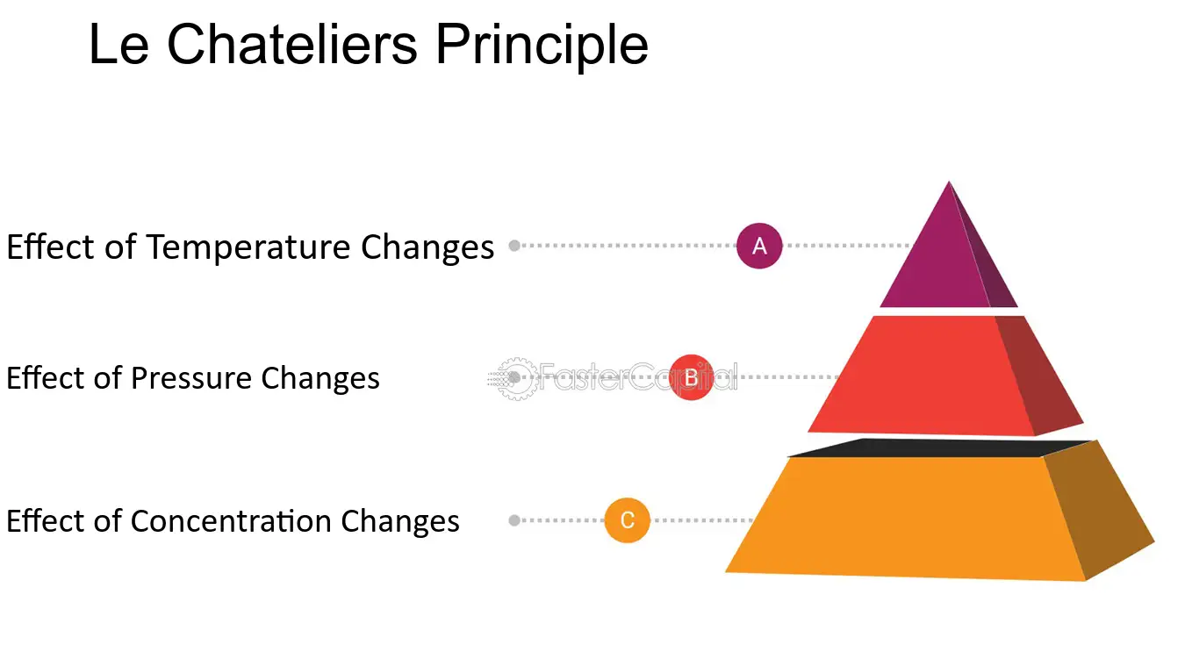
LE CHATELIER'S PRINCIPLE
Definition: Le Chatelier’s Principle states that if a system at equilibrium is disturbed by a change in concentration, pressure, or temperature, the system will adjust to counteract that change and restore a new equilibrium.
Effect of Temperature Changes:
In an exothermic reaction, increasing temperature shifts equilibrium toward the reactants (heat is a product).
In an endothermic reaction, increasing temperature shifts equilibrium toward the products (heat is a reactant).
Effect of Pressure Changes (for Gases):
Increasing pressure shifts the equilibrium towards the side with fewer gas molecules.
Decreasing pressure shifts it towards the side with more gas molecules.
Effect of Concentration Changes:
Adding more of a reactant or product shifts the equilibrium to consume the added substance.
Removing a substance shifts the equilibrium to replace it.

Slide 7
THANK YOU!

